Slide 1

ITCS 6160/8160: Term Project
Group 13
Devashri Gadgil,
Ramakrishna Kolipaka,
Madison Melton,
Mohammed Puthiyottil

Slide 2
Project Overview
Given: a test database for a campus controlled food delivery service similar to craveoncampus.com
Tasks
Fully normalize database and create updated EERD
Enhance database with a rating system for restaurants and delivery drivers
Create views, indexes, and stored procedures

Slide 3
Deliverable 1
Met with group members
Created group contract
Created project repository

Slide 4
Deliverable 2
Reverse engineered the current database to it’s EERD
Added new tables to enable a more extensive ordering system
order_status
payment
order_rating
order_items
menu
Fully normalized the database following the given restraints
Reverse engineered the database again to include the new tables

Slide 5
Deliverable 3
Created various stored procedures, indexes, and views

Slide 6
Stored Procedure A
Shows the Max, Min, and Average for Food and Delivery rating when given a specific restaurant id
Input
Output

Slide 7
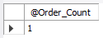
Stored Procedure B
Displays a count of the orders made by a customer for a specified date range when given a customer id
Input
Output

Slide 8
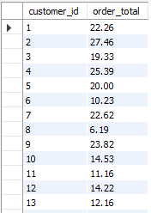
Stored Procedure C
Displays total price of the orders by each customer (distinct) for a specified date range
Input
Output

Slide 9
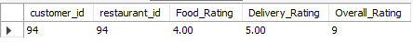
Stored Procedure D
Displays a particular customer’s rating for a restaurant
Input
Output

Slide 10
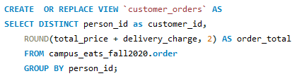
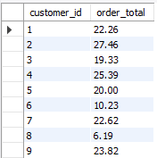
View #1
Displays the total price of the orders by each customer over all time
View
Output

Slide 11
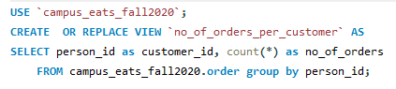
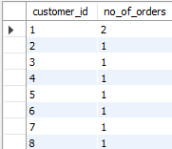
View #2
Displays the number of orders per customer
View
Output

Slide 12
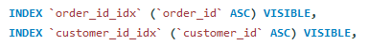
Indexes
Two indexes are present in the payment table
order_id_idx
customer_id_idx

Slide 13
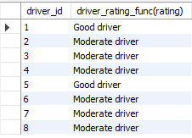
Function #1
Assigns a label to each driver_id based on their delivery rating. Label options are Bad, Below Average, Moderate, Good, Expert, based on the 1 to 5 rating system
Function Call
Output

